Slide 1
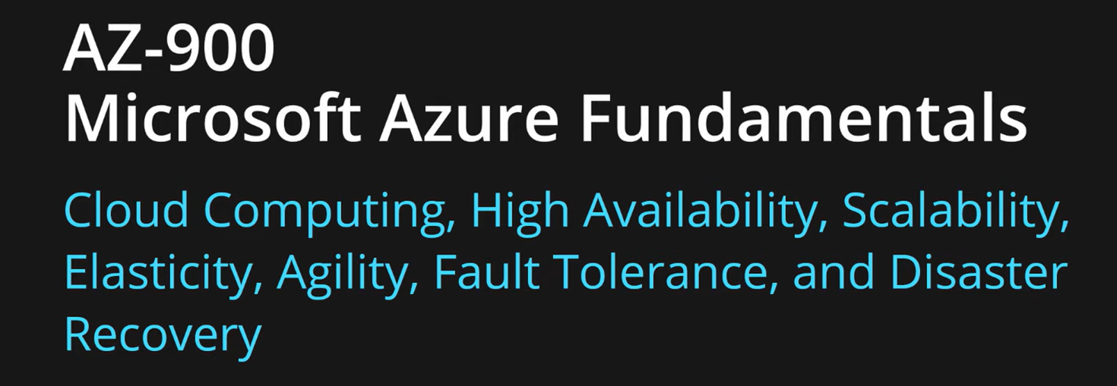
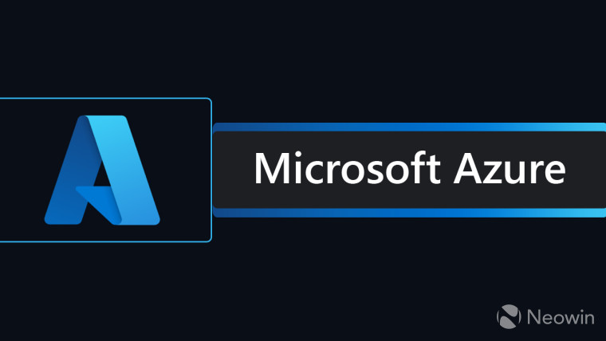

Slide 2
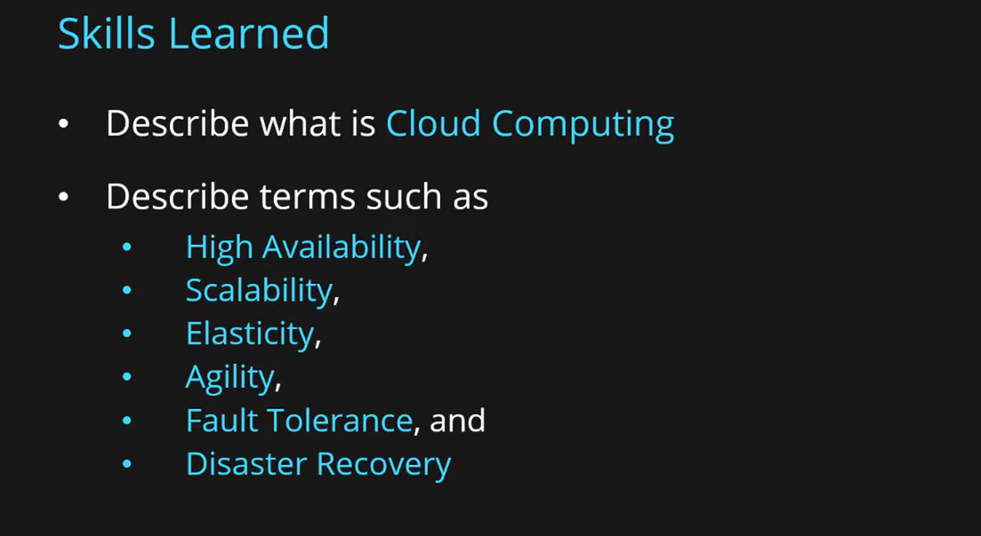

Slide 3
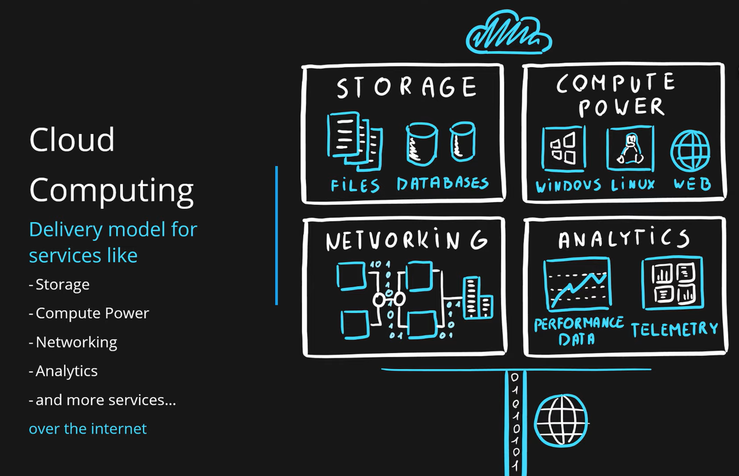

Slide 4
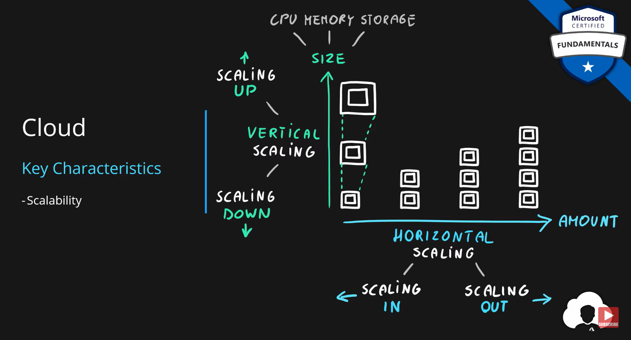
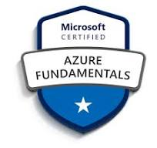

Slide 5
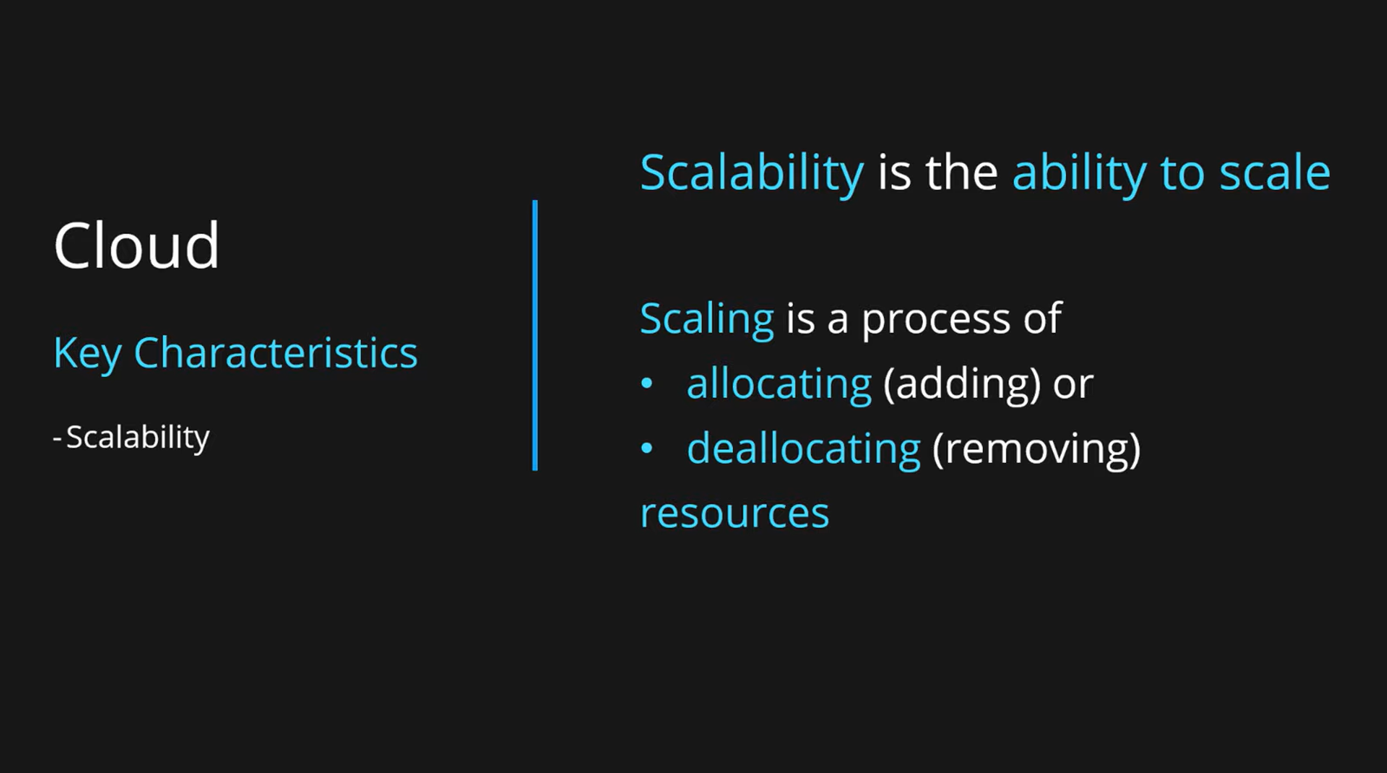

Slide 6
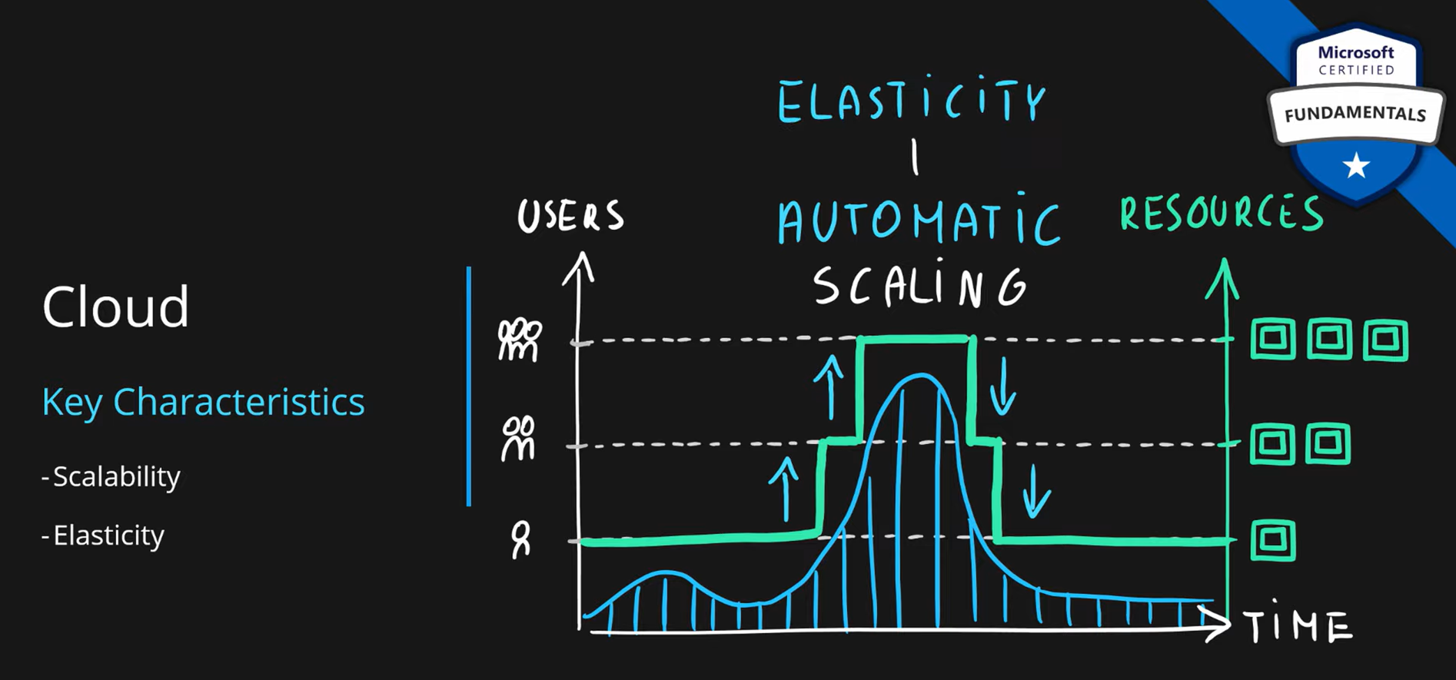
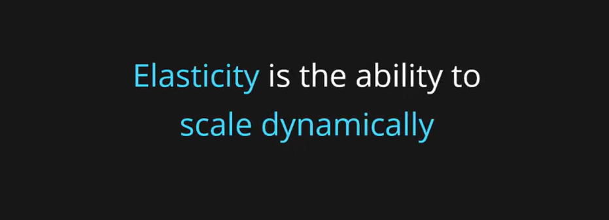

Slide 7
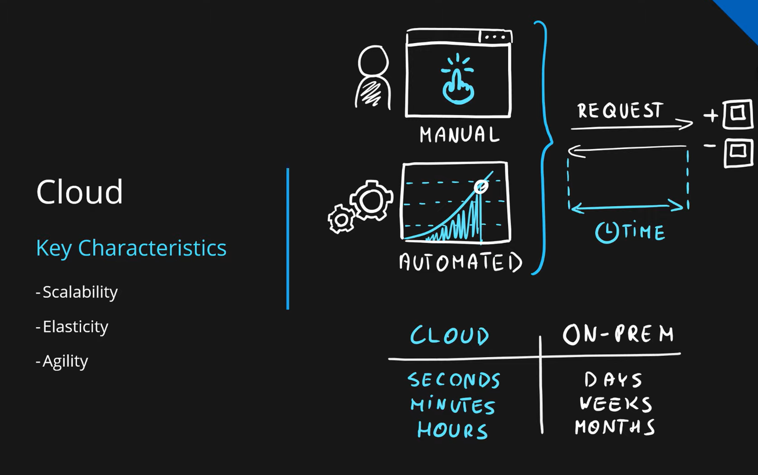
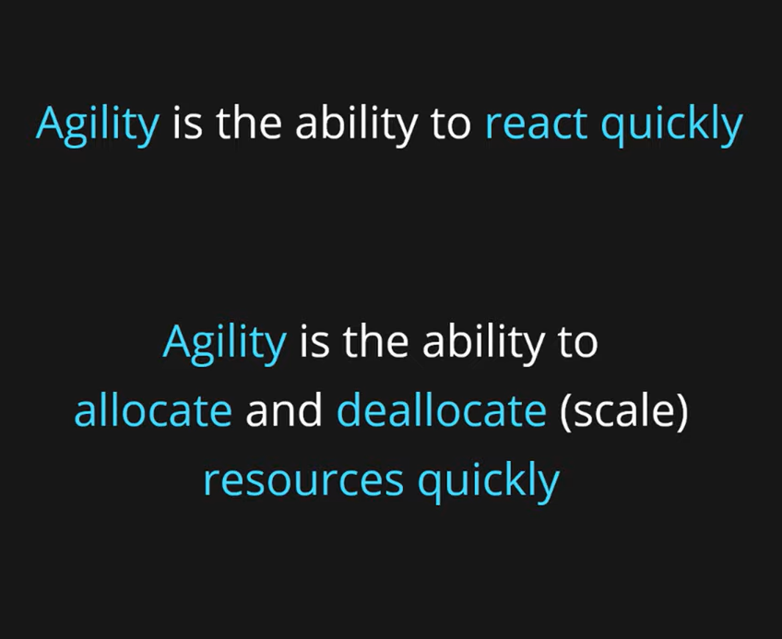

Slide 8
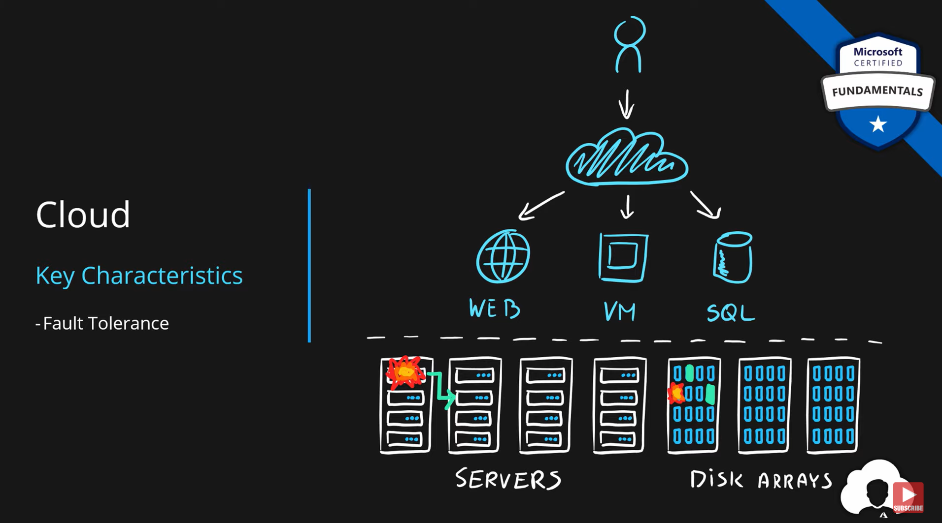

Slide 9
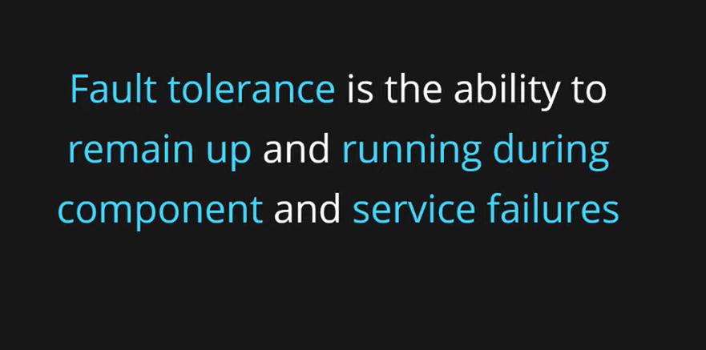
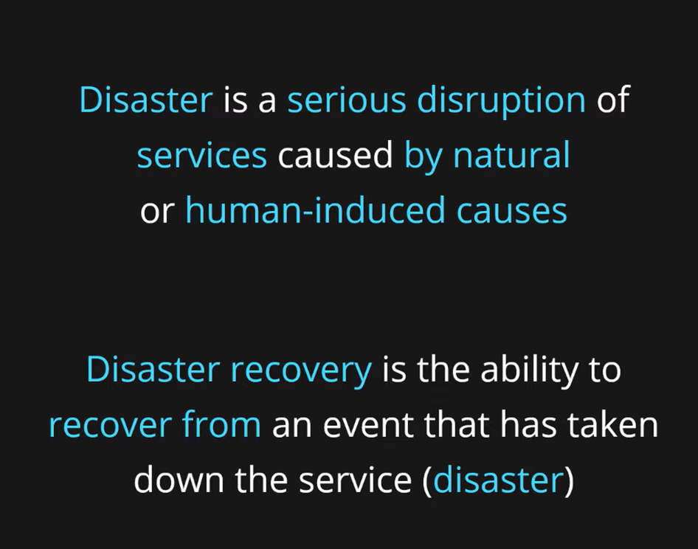
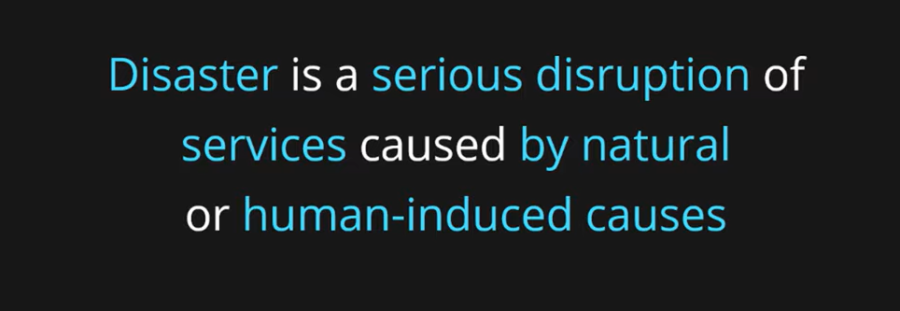

Slide 10
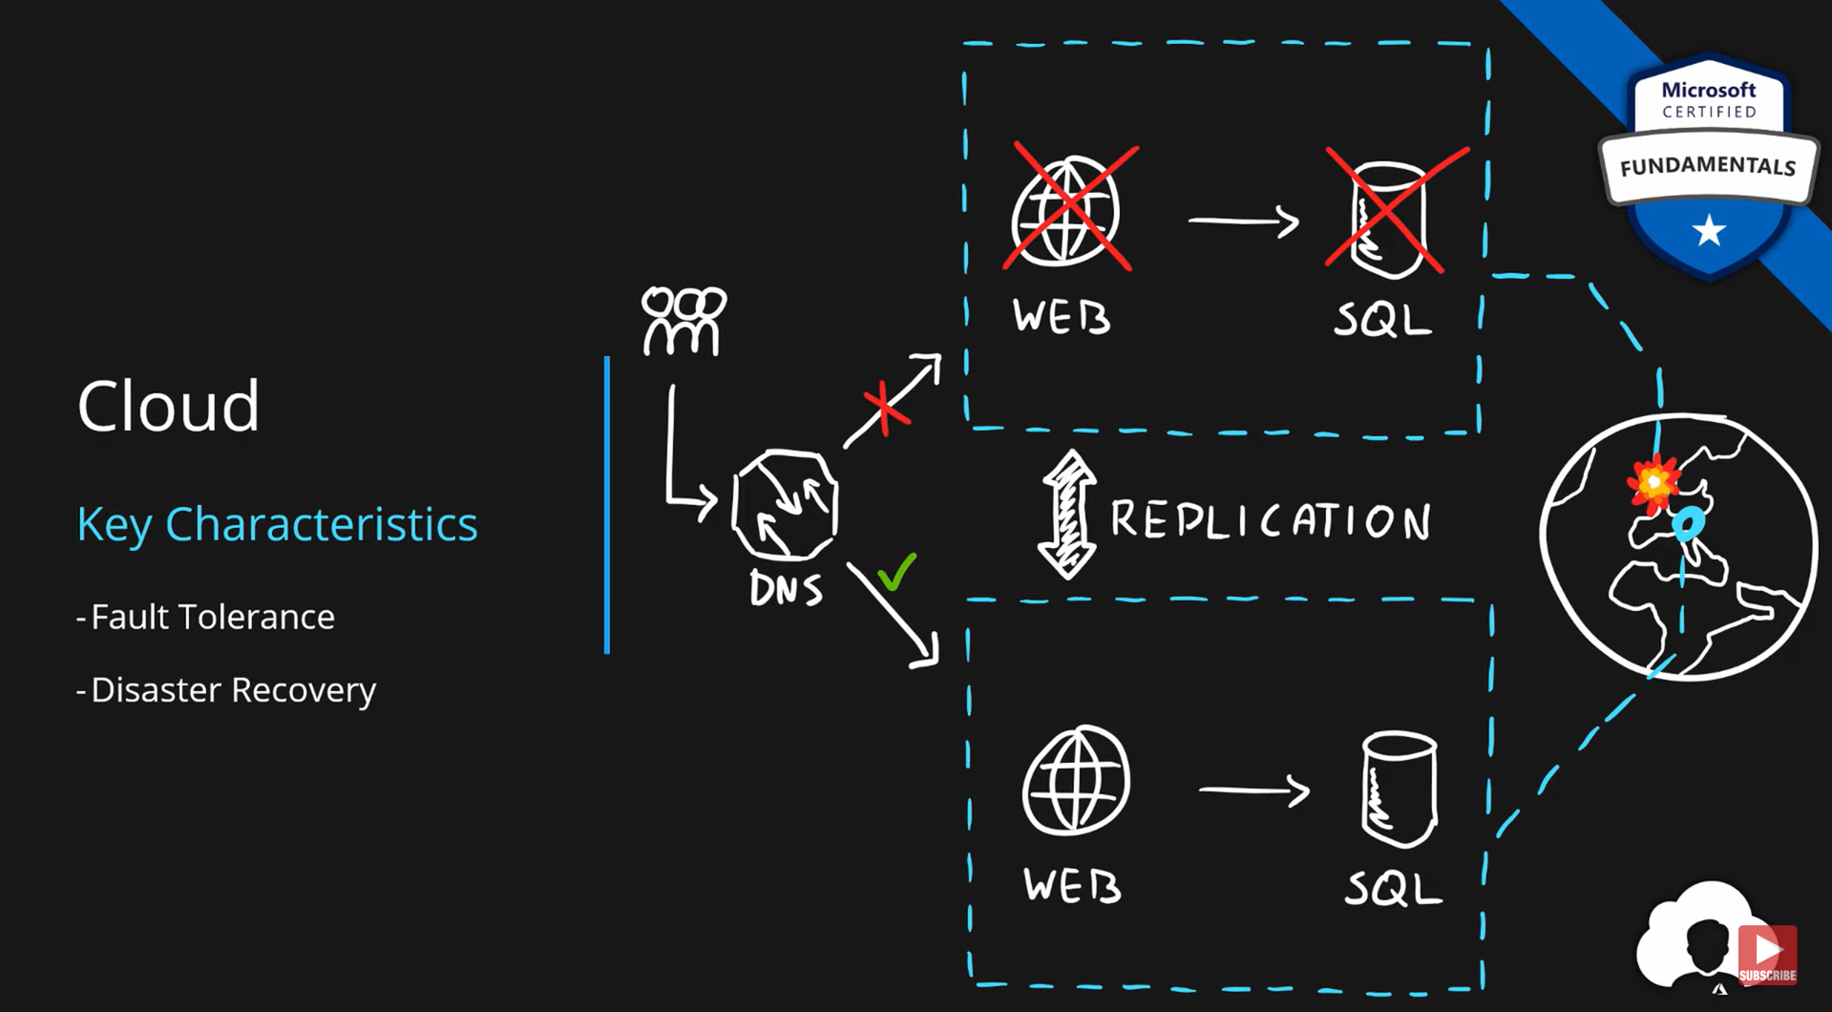

Slide 11
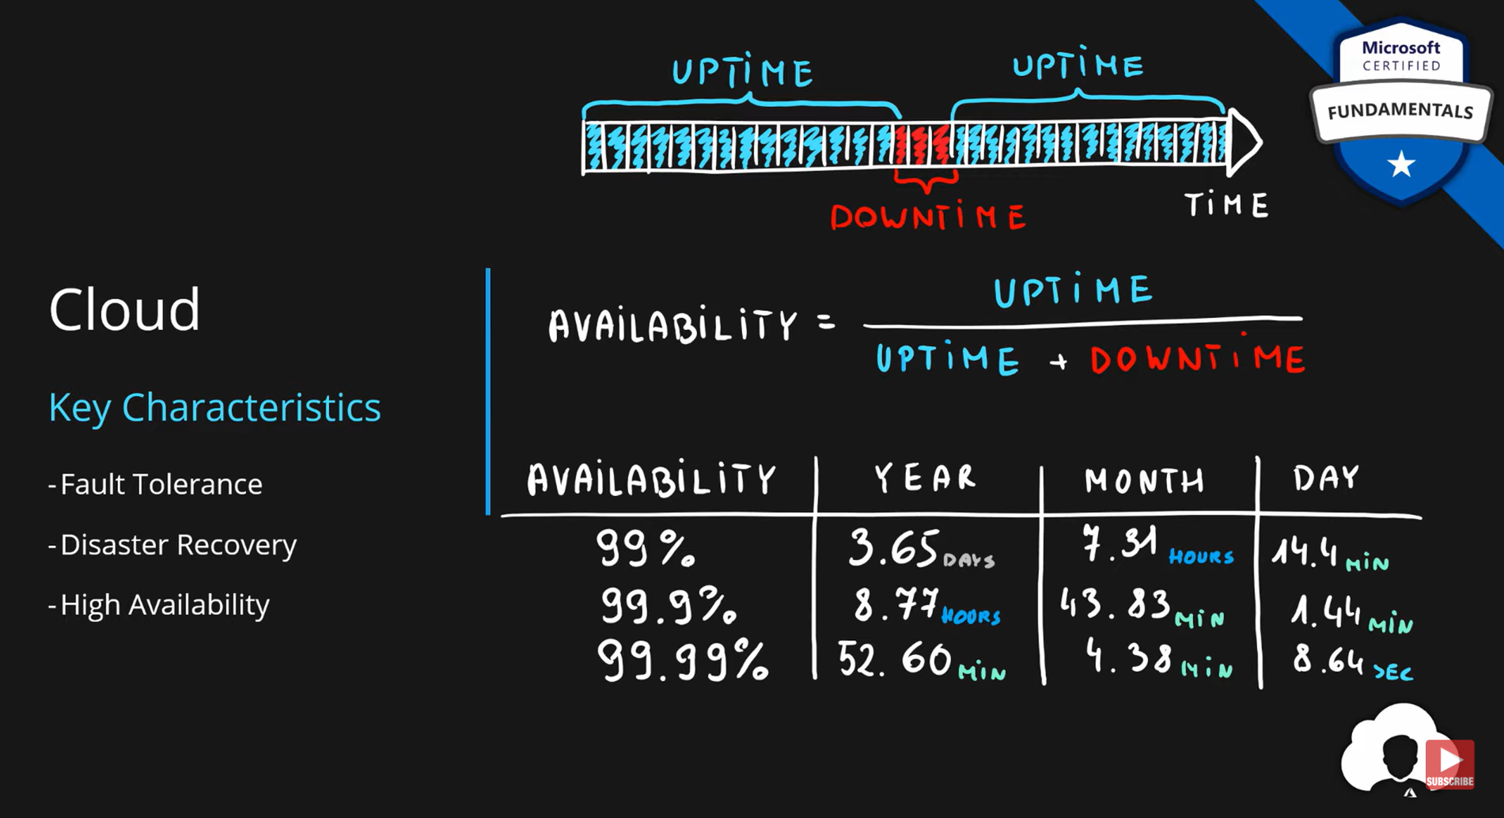

Slide 12
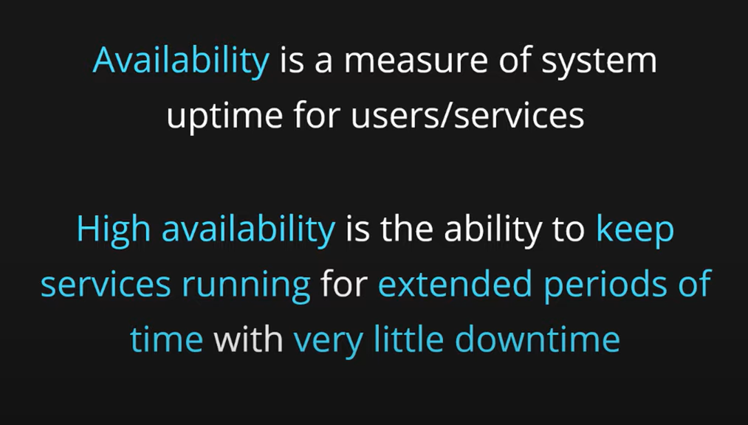

Slide 13
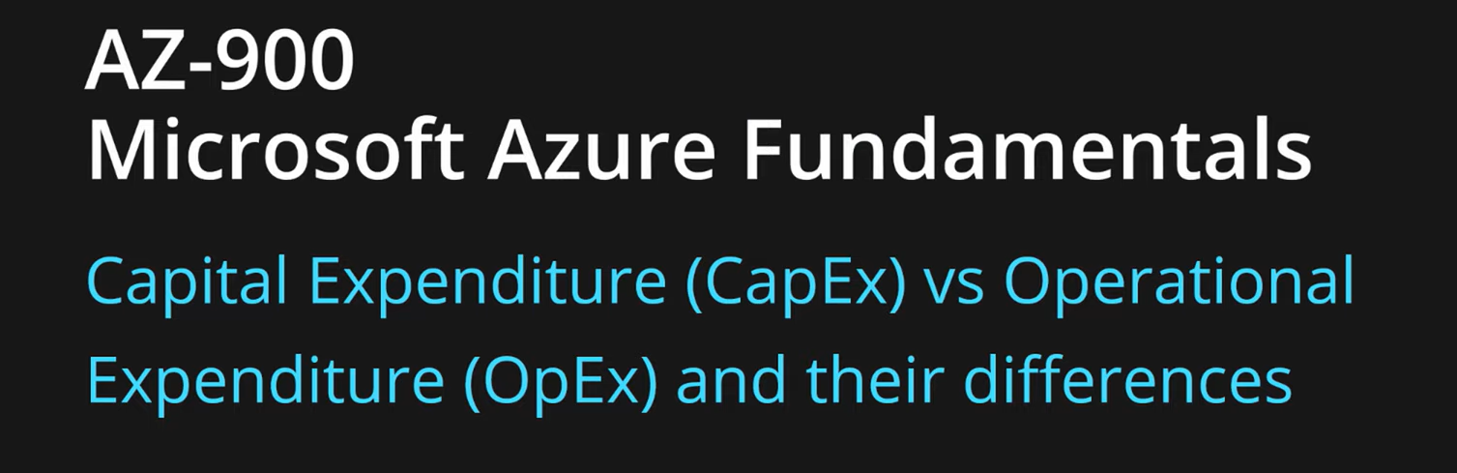

Slide 14
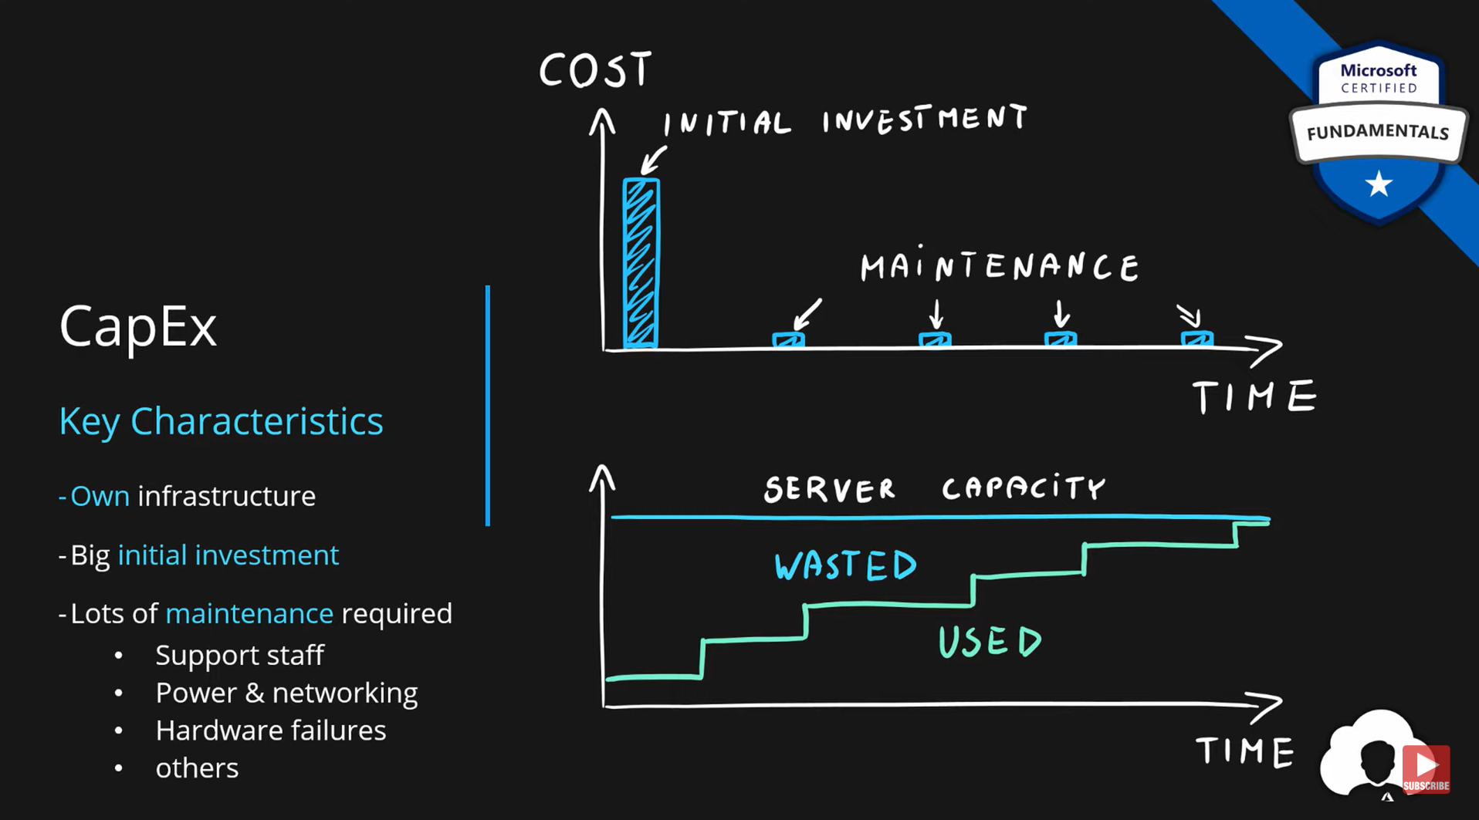

Slide 15
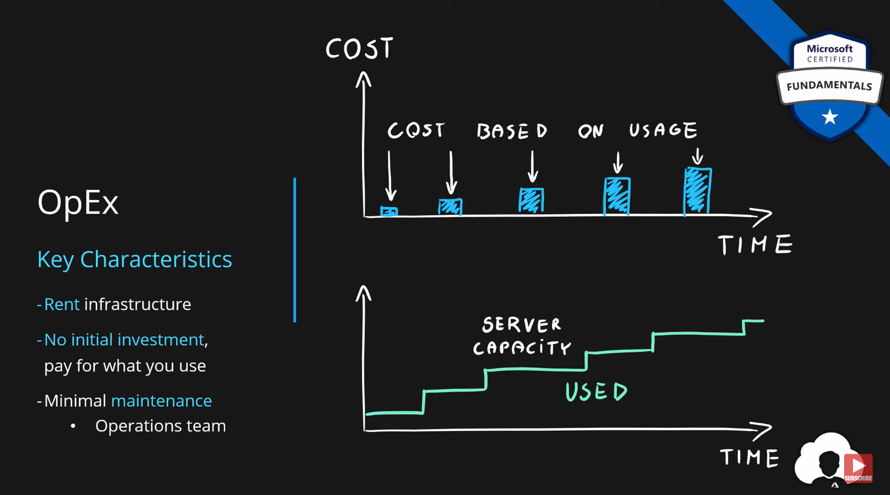

Slide 16
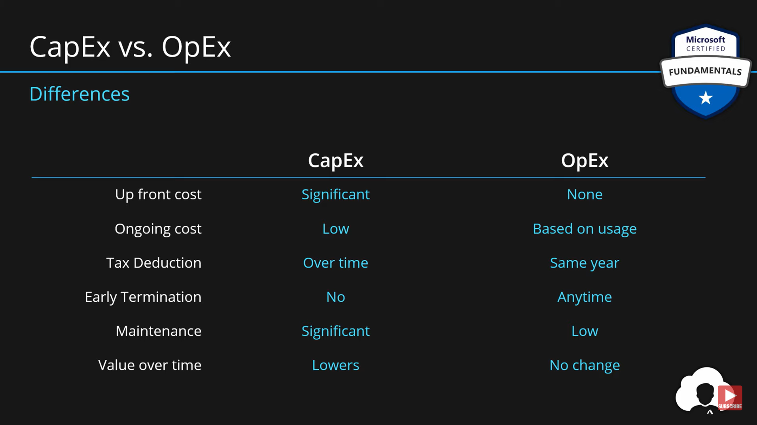

Slide 17
Learning objectives
After completing this module, you’ll be able to:
Define cloud computing.
Describe the shared responsibility model.
Define cloud models, including public, private, and hybrid.
Identify appropriate use cases for each cloud model.
Describe the consumption-based model.
Compare cloud pricing models.

Slide 18
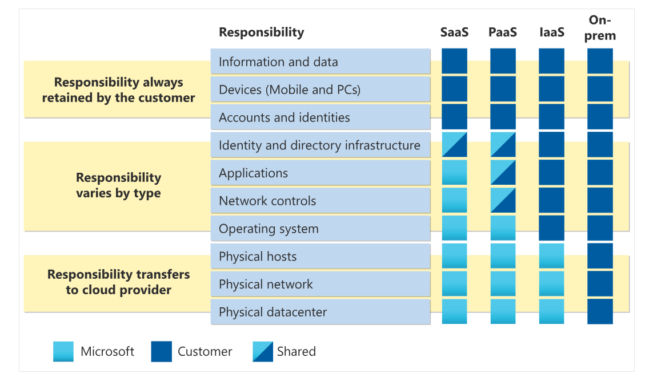
Describe the shared responsibility model

Slide 19
You’ll always be responsible for:
The information and data stored in the cloud
Devices that are allowed to connect to your cloud (cell phones, computers, and so on)
The accounts and identities of the people, services, and devices within your organization
The cloud provider is always responsible for:
The physical datacenter
The physical network
The physical hosts
Your service model will determine responsibility for things like:
Operating systems
Network controls
Applications
Identity and infrastructure

Slide 20
Start with a traditional corporate datacenter. The company is responsible for maintaining the physical space, ensuring security, and maintaining or replacing the servers if anything happens. The IT department is responsible for maintaining all the infrastructure and software needed to keep the datacenter up and running. They’re also likely to be responsible for keeping all systems patched and on the correct version.
With the shared responsibility model, these responsibilities get shared between the cloud provider and the consumer. Physical security, power, cooling, and network connectivity are the responsibility of the cloud provider. The consumer isn’t collocated with the datacenter, so it wouldn’t make sense for the consumer to have any of those responsibilities.
At the same time, the consumer is responsible for the data and information stored in the cloud. (You wouldn’t want the cloud provider to be able to read your information.) The consumer is also responsible for access security, meaning you only give access to those who need it.

Slide 21
Multi-cloud
A fourth, and increasingly likely scenario is a multi-cloud scenario. In a multi-cloud scenario, you use multiple public cloud providers. Maybe you use different features from different cloud providers. Or maybe you started your cloud journey with one provider and are in the process of migrating to a different provider. Regardless, in a multi-cloud environment you deal with two (or more) public cloud providers and manage resources and security in both environments.
Azure Arc
Azure Arc is a set of technologies that helps manage your cloud environment. Azure Arc can help manage your cloud environment, whether it's a public cloud solely on Azure, a private cloud in your datacenter, a hybrid configuration, or even a multi-cloud environment running on multiple cloud providers at once.
Azure VMware Solution
What if you’re already established with VMware in a private cloud environment but want to migrate to a public or hybrid cloud? Azure VMware Solution lets you run your VMware workloads in Azure with seamless integration and scalability.

Slide 22
Learning objectives
After completing this module, you’ll be able to:
Describe Azure regions, region pairs, and sovereign regions.
Describe Availability Zones.
Describe Azure datacenters.
Describe Azure resources and Resource Groups.
Describe subscriptions.
Describe management groups.
Describe the hierarchy of resource groups, subscriptions, and management groups.

Slide 23
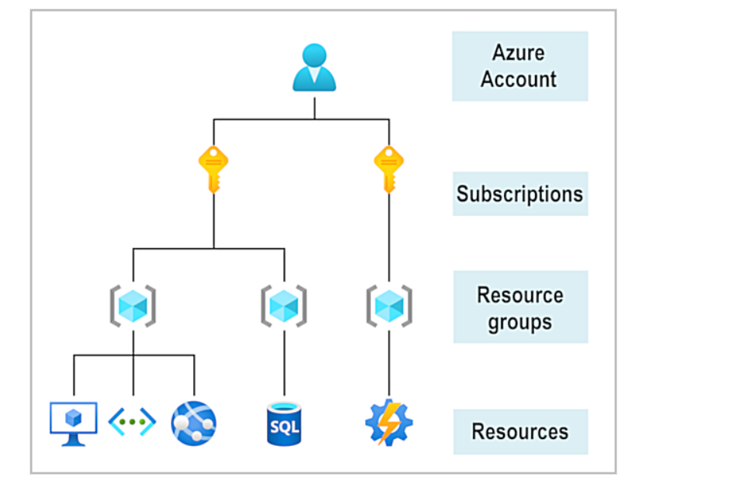
Get started with Azure accounts
To create and use Azure services, you need an Azure subscription. When you're completing Learn modules, most of the time a temporary subscription is created for you, which runs in an environment called the Learn sandbox. When you're working with your own applications and business needs, you need to create an Azure account, and a subscription will be created for you. After you've created an Azure account, you're free to create additional subscriptions. For example, your company might use a single Azure account for your business and separate subscriptions for development, marketing, and sales departments. After you've created an Azure subscription, you can start creating Azure resources within each subscription.

Slide 24
Describe Azure physical infrastructure
Microsoft Azure, you’ll hear and use terms like Regions, Availability Zones, Resources, Subscriptions, and more. This module focuses on the core architectural components of Azure. The core architectural components of Azure may be broken down into two main groupings: the physical infrastructure, and the management infrastructure.
Physical infrastructure:
The physical infrastructure for Azure starts with datacenters. Conceptually, the datacenters are the same as large corporate datacenters. They’re facilities with resources arranged in racks, with dedicated power, cooling, and networking infrastructure.
As a global cloud provider, Azure has datacenters around the world. However, these individual datacenters aren’t directly accessible. Datacenters are grouped into Azure Regions or Azure Availability Zones that are designed to help you achieve resiliency and reliability for your business-critical workloads.
The Global infrastructure site gives you a chance to interactively explore the underlying Azure infrastructure.
Regions :
A region is a geographical area on the planet that contains at least one, but potentially multiple datacenters that are nearby and networked together with a low-latency network. Azure intelligently assigns and controls the resources within each region to ensure workloads are appropriately balanced.
When you deploy a resource in Azure, you'll often need to choose the region where you want your resource deployed.

Slide 25
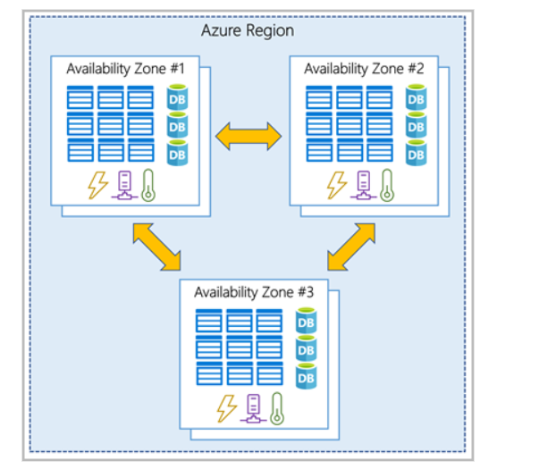
Availability Zones:
Availability zones are physically separate datacenters within an Azure region. Each availability zone is made up of one or more datacenters equipped with independent power, cooling, and networking. An availability zone is set up to be an isolation boundary. If one zone goes down, the other continues working. Availability zones are connected through high-speed, private fiber-optic networks.

Slide 26
Use availability zones in your apps
You want to ensure your services and data are redundant so you can protect your information in case of failure. When you host your infrastructure, setting up your own redundancy requires that you create duplicate hardware environments. Azure can help make your app highly available through availability zones.
You can use availability zones to run mission-critical applications and build high-availability into your application architecture by co-locating your compute, storage, networking, and data resources within an availability zone and replicating in other availability zones. Keep in mind that there could be a cost to duplicating your services and transferring data between availability zones.
Availability zones are primarily for VMs, managed disks, load balancers, and SQL databases. Azure services that support availability zones fall into three categories:
Zonal services: You pin the resource to a specific zone (for example, VMs, managed disks, IP addresses).
Zone-redundant services: The platform replicates automatically across zones (for example, zone-redundant storage, SQL Database).
Non-regional services: Services are always available from Azure geographies and are resilient to zone-wide outages as well as region-wide outages.
Even with the additional resiliency that availability zones provide, it’s possible that an event could be so large that it impacts multiple availability zones in a single region. To provide even further resilience, Azure has Region Pairs.

Slide 27
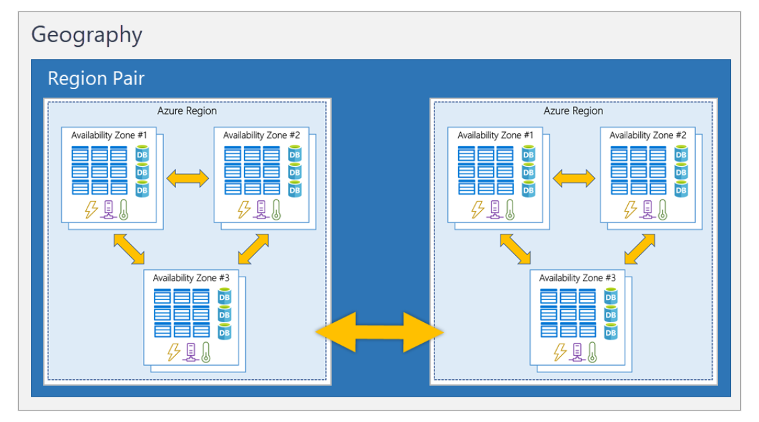
Region pairs
Most Azure regions are paired with another region within the same geography (such as US, Europe, or Asia) at least 300 miles away. This approach allows for the replication of resources across a geography that helps reduce the likelihood of interruptions because of events such as natural disasters, civil unrest, power outages, or physical network outages that affect an entire region. For example, if a region in a pair was affected by a natural disaster, services would automatically fail over to the other region in its region pair.
Examples of region pairs in Azure are West US paired with East US and South-East Asia paired with East Asia. Because the pair of regions are directly connected and far enough apart to be isolated from regional disasters, you can use them to provide reliable services and data redundancy.

Slide 28
Additional advantages of region pairs:
If an extensive Azure outage occurs, one region out of every pair is prioritized to make sure at least one is restored as quickly as possible for applications hosted in that region pair.
Planned Azure updates are rolled out to paired regions one region at a time to minimize downtime and risk of application outage.
Data continues to reside within the same geography as its pair (except for Brazil South) for tax- and law-enforcement jurisdiction purposes.
Sovereign Regions
In addition to regular regions, Azure also has sovereign regions. Sovereign regions are instances of Azure that are isolated from the main instance of Azure. You may need to use a sovereign region for compliance or legal purposes.
Azure sovereign regions include:
US DoD Central, US Gov Virginia, US Gov Iowa and more: These regions are physical and logical network-isolated instances of Azure for U.S. government agencies and partners. These datacenters are operated by screened U.S. personnel and include additional compliance certifications.
China East, China North, and more: These regions are available through a unique partnership between Microsoft and 21Vianet, whereby Microsoft doesn't directly maintain the datacenters.

Slide 29
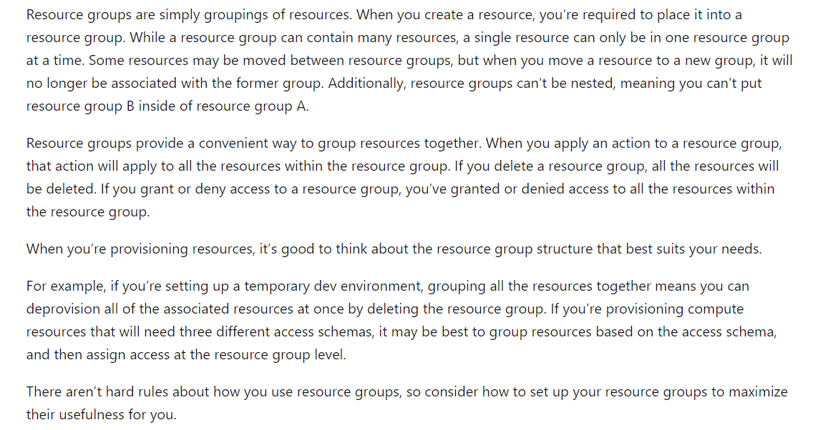
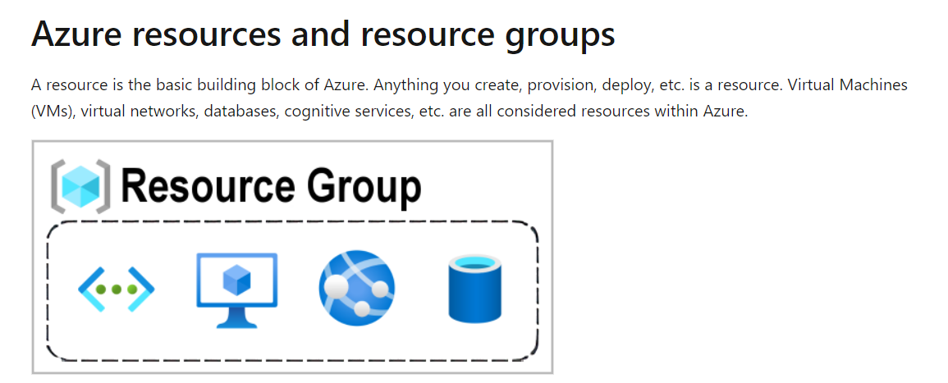

Slide 30
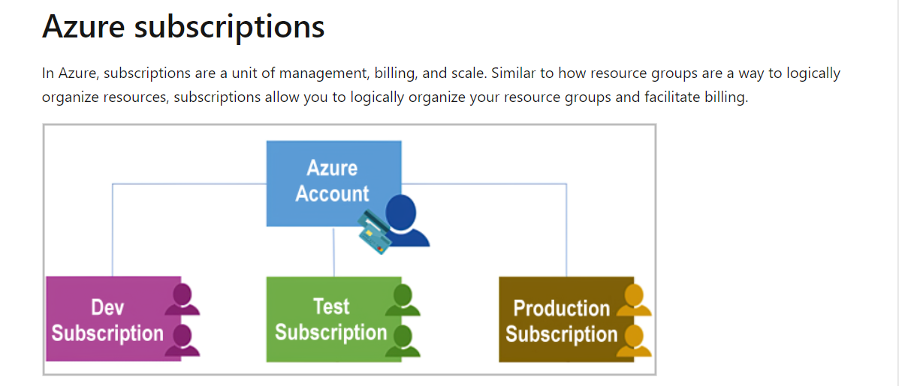
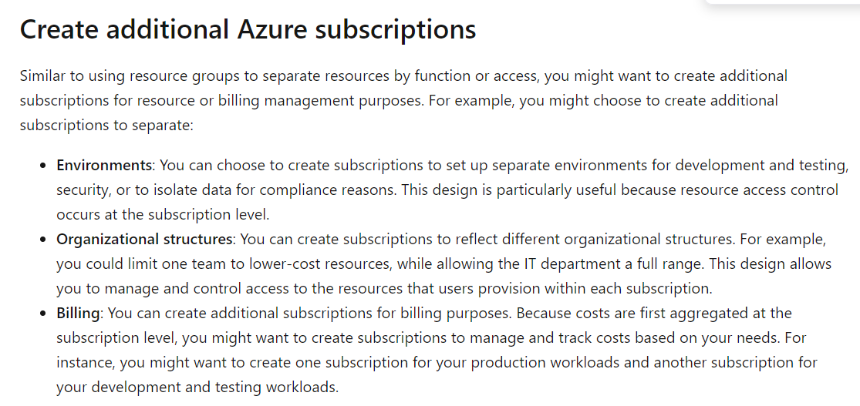
Billing boundary: This subscription type determines how an Azure account is billed for using Azure. You can create multiple subscriptions for different types of billing requirements. Azure generates separate billing reports and invoices for each subscription so that you can organize and manage costs.
Access control boundary: Azure applies access-management policies at the subscription level, and you can create separate subscriptions to reflect different organizational structures. An example is that within a business, you have different departments to which you apply distinct Azure subscription policies. This billing model allows you to manage and control access to the resources that users provision with specific subscriptions.

Slide 31
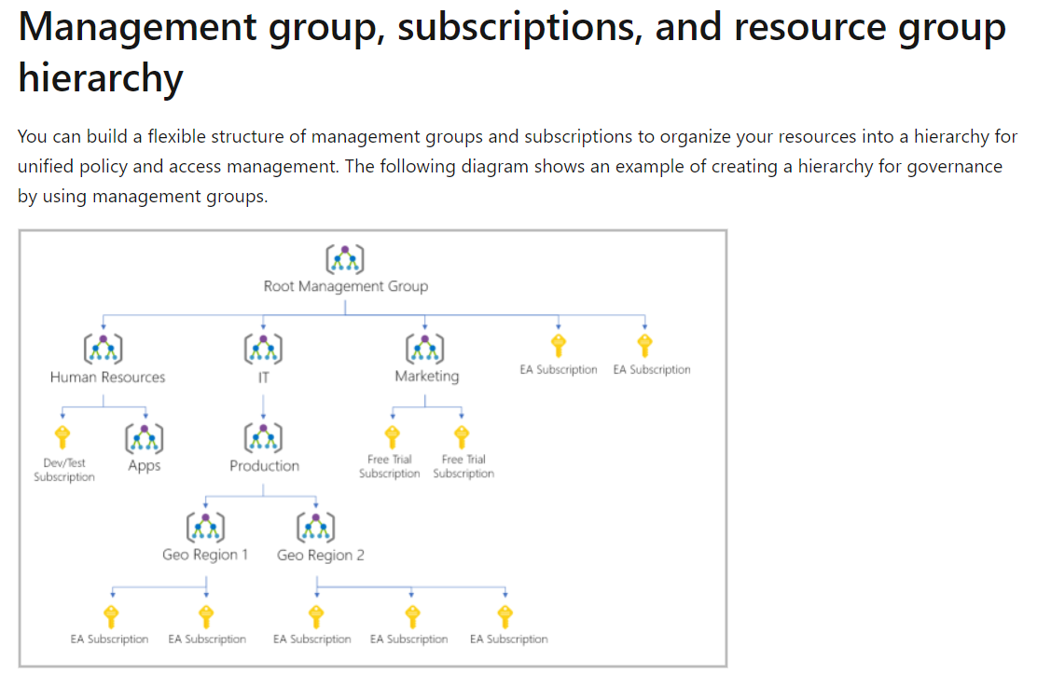

Slide 32
Azure management groups
Create a hierarchy that applies a policy. You could limit VM locations to the US West Region in a group called Production. This policy will inherit onto all the subscriptions that are descendants of that management group and will apply to all VMs under those subscriptions. This security policy can't be altered by the resource or subscription owner, which allows for improved governance.
Provide user access to multiple subscriptions. By moving multiple subscriptions under a management group, you can create one Azure role-based access control (Azure RBAC) assignment on the management group. Assigning Azure RBAC at the management group level means that all sub-management groups, subscriptions, resource groups, and resources underneath that management group would also inherit those permissions. One assignment on the management group can enable users to have access to everything they need instead of scripting Azure RBAC over different subscriptions.
Important facts about management groups:
10,000 management groups can be supported in a single directory.
A management group tree can support up to six levels of depth. This limit doesn't include the root level or the subscription level.
Each management group and subscription can support only one parent.

Slide 33
Microsoft Azure Fundamentals: Describe Azure architecture and services
Describe Azure virtual machines
With Azure Virtual Machines (VMs), you can create and use VMs in the cloud. VMs provide infrastructure as a service (IaaS) in the form of a virtualized server and can be used in many ways. Just like a physical computer, you can customize all of the software running on your VM. VMs are an ideal choice when you need:
Total control over the operating system (OS).
The ability to run custom software.
To use custom hosting configurations.
An Azure VM gives you the flexibility of virtualization without having to buy and maintain the physical hardware that runs the VM. However, as an IaaS offering, you still need to configure, update, and maintain the software that runs on the VM.
VM Resources
When you provision a VM, you’ll also have the chance to pick the resources that are associated with that VM, including:
Size (purpose, number of processor cores, and amount of RAM)
Storage disks (hard disk drives, solid state drives, etc.)
Networking (virtual network, public IP address, and port configuration)

Slide 34
https://learn.microsoft.com/en-us/credentials/certifications/exams/az-900/

